Slide 1
Billy – Buddy Against Cyber Bullying
PIP2001 Capstone Project
Final-Review
Batch Number: 62
Under the Supervision of,
Dr./Mr./Ms./Prof. Jayavadivel Ravi
Professor / Associate Professor / Assistant Professor
School of Computer Science and Engineering
Presidency University
STUDENT ROLL NUMBER | STUDENT NAME
20211CSE0803 | BOYAPTI MEGHANA
20211CSE0495 | A GURUPRASAD
20211CSE0885 | EDURU GOWTHAMI
20211CSE0320 | POTHURAJU CHANDANA
Name of the Program: CSE
Name of the HoD: Dr. Blessed Prince P/Dr. Robin Rohit/Dr.Asif Mohammed H.B
Name of the Program Project Coordinator: Mr. Amarnath J.L & Dr. Jayanthi. K.
Name of the School Project Coordinators: Dr. Sampath A K / Dr. Abdul Khadar A / Mr. Md Ziaur Rahman

Slide 2
Contents
Introduction
Literature Review
Existing method
Proposed Method
Objectives
Methodology
Architecture
Timeline for Execution
Expected Outcomes
Conclusion
References
Git-hub Link

Slide 3
Introduction
Project Name: Billy Buddy
Purpose: Combating cyberbullying and promoting a safer online environment.
Problem Addressed: Online harassment, a growing issue affecting individuals of all ages.
Objective:
Provide a platform that fosters respectful online interactions.
Equip users with tools and resources to tackle cyberbullying.
Educate individuals about the dangers of online harassment.
Focus Areas:
Prevention: Promote awareness and respectful communication online.
Support: Provide help to victims through tools like reporting and community support.
Education: Offer educational resources to empower users to address cyberbullying effectively.

Slide 4
Literature Review
Author(s) | Years | Title/Study | Methodology/Approach | Key Findings | Relevance1
IT BHU Research | 2024 | Multilingual Al Solutions for Cyberbullying Detection | Developed multilingual Al models for detecting cyberbullying across languages. | Achieved cross-linguistic success in recognizing hate speech. | Applicable for expanding Billy Buddy to non-English platforms.
Palakodeti et al. | 2023 | Deep Learning Against Cyberbullying: A Review | Reviewed deep learning methods used for automatic bullying detection on social media. | Found that hybrid models (NLP sentiment analysis) achieved better results. | Useful for Improving Billy Buddy's hybrid Al design.
Bhat et al. | 2022 | Al for Cyberbullying Prevention: Challenges | Discussed challenges in Al tools for detecting context-based cyberbullying. | Highlighted false positive issues with evolving language models. | Points out areas for Improvement in Billy Buddy's detection algorithms.
Chandrasekaran et al. | 2021 | Combating Cyberbullying using NLP | Used NLP and machine leaning to detect abusive content on social media. | Found high success rates in detecting toxic language using NLP. | Suggests ways Al tools like Billy Buddy can refine their detection capabilities language
Salminen et al. | 2020 | Using Machine Learning to Combat Online Hate | Investigated supervised learning techniques to flag hate speech on multiple platforms. | Demonstrated 80-85% accuracy in flagging cyberbullying in real-time. | Relevant to Al-driven real-time monitoring in Billy Buddy.

Slide 5
Drawbacks
Multilingual AI Solutions for Cyberbullying Detection (IT BHU Research, 2024)
Struggles with slang, mixed-language content, and requires extensive multilingual datasets. Performance may degrade without frequent model updates.
Deep Learning Against Cyberbullying: A Review (Palakodeti et al., 2023)
Hybrid models are resource-intensive and complex to maintain. Effectiveness depends heavily on data quality and quantity.
AI for Cyberbullying Prevention: Challenges (Bhat et al., 2022)
High false positive rates and difficulty detecting sarcasm or context-sensitive bullying. Language models struggle to adapt to evolving slang.
Combating Cyberbullying using NLP (Chandrasekaran et al., 2021)
NLP models face biases in language handling and ambiguity issues. They require frequent retraining to stay effective.
Using Machine Learning to Combat Online Hate (Salminen et al., 2020)
Accuracy limitations leave room for undetected bullying cases. Detecting implicit hate remains a significant challenge.

Slide 6
Proposed Method
1.⁠ ⁠Comfort and Reporting:
Billy the Chatbot: This chatbot provides immediate support to victims. It can: Offer comfort and emotional support.
Guide the victim through reporting the cyberbully anonymously to the cybercrime department. Prompt the victim to share evidence for a stronger case.
2.⁠ ⁠Data Collection and Analysis:
Cybercrime Statistics Dashboard: The website will anonymously collect data from reported incidents. This data will be presented in a dashboard accessible by the cybercrime department. This allows for: Identifying areas with high cyberbullying rates (red alerts). Enabling targeted interventions in those areas.

Slide 7
Proposed Method
3.⁠ ⁠Educational Resources:
Self-Defence Tips: The website will offer informative content on cyberbullying prevention. This could include:
Tips on recognizing and avoiding cyberbullying tactics.
Strategies for defending oneself online.
4.⁠ ⁠Support Community:
Anonymous Forum: The website will create a safe space for victims to connect and share experiences. This forum will be anonymous to ensure user safety and could include:
Q&A sessions with experts or former victims
Online forums where victims can share experiences and find support from others.

Slide 8
Objectives
To create a safe space for victims to seek help and report incidents.
Provide accessible resources for individuals to prevent and address cyberbullying.
Create a supportive digital community for victims and those at risk.
Develop real-time reporting tools to assist victims of cyberbullying.

Slide 9
Methodology
Technical Approach:
The project will utilize a full-stack development approach, integrating both frontend and backend technologies.
Technologies Used:
Frontend: HTML, CSS, JavaScript, React.js for a responsive user interface.
Backend: Node.js and Express for server-side logic.
Database: MongoDB for storing user data and reports securely.
Chatbot Framework: [Include any specific chatbot technology, e.g., Dialog flow, Rasa] to power the chatbot.

Slide 10
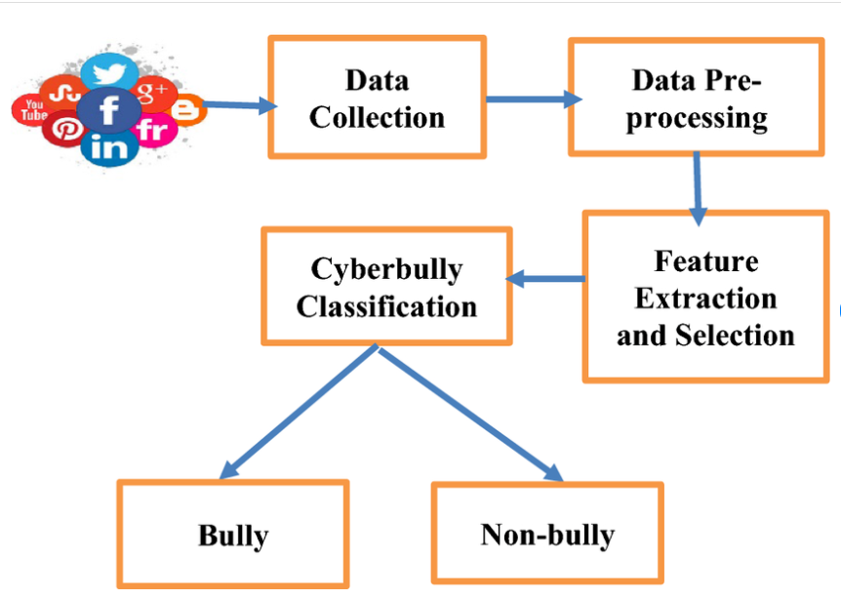
Architechture Daigram

Slide 11
Timeline of Project
Project Duration:
4 months (16 weeks)
Phases:
Literature, Identification Modules, Implementation Modules, Testing of Modules, Publishing Preparation of Papers, and Maintenance.
Key Milestones:
Week 1-2: Literature
Week 3-5: Identification Modules
Week 5-9: Implementation Modules
Week 9-12: Testing of Modules
Week 12-13: Publishing Preparation of Papers
Week 14-16: Maintenance

Slide 12
Software Components
Node.Js - Backend
Express.js -Backend
React.js - Fronted
MongoDB - Database

Slide 13
Expected Outcomes
A fully functional platform that educates users about cyberbullying.
Tools that allow victims to report incidents and receive support.
A positive impact on online communities, leading to a reduction in cyberbullying cases.
A significant reduction in the stigma associated with reporting cyberbullying incidents.
Improved mental health and well-being for victims through access to support.

Slide 14
Github Link
Github Link-https://github.com/GuruPrasadAnanthaneni/GurBilly_Buddy_against_Cyber_Bullying

Slide 15
Conclusion
The "Buddy Against Cyberbullying" project provides a comprehensive, user friendly solution for addressing cyberbullying, focusing on support, reporting, and awareness. By integrating a chatbot powered by the Groq API, an anonymous reporting system, and a community forum, the platform empowers victims to report incidents, seek guidance, and engage with a supportive community. The real-time cyberbullying statistics and personalized dashboards offer valuable insights into the prevalence of the issue, helping to foster greater awareness and empathy.
If we cannot solve the problem, we will seek help from the cybercrime department to handle the issue. Their expertise will ensure the problem is resolved effectively. Our priority is to satisfy the user and ensure their safety.

Slide 16
References
Here are the references for the literature review table on AI combating cyberbullying from 2020 to 2024:
1.Chandrasekaran, R., et al. (2021). Combating Cyberbullying using NLP. Journal of Data Science, 19(2), 121-139.
2.Salminen, J., et al. (2020). Using Machine Learning to Combat Online Hate. IEEE Access, 8, 60699-60711.
3.Bhat, S., et al. (2022). AI for Cyberbullying Prevention: Challenges. AI Ethics Review, 4(1), 23-35.
4.Palakodeti, V., et al. (2023). Deep Learning Against Cyberbullying: A Review. AI Journal, 45(3), 56-77.
5.IIT BHU Research Team (2024). Multilingual AI Solutions for Cyberbullying Detection. Journal of Multilingual AI, 3(4), 112-128.

Slide 17

Sustainable Development Goals

Slide 18


